Slide 1
BITS Pilani presentation
K. Venkata Ratnam
Mathematics

Slide 2
Course Number : SS ZC416
Course Title: MATHEMATICAL FOUNDATIONS
FOR DATA SCIENCE
Lecture No. :16

Slide 3
Boolean Algebra- Boolean Functions
Representing Boolean functions.

Slide 4
Introduction
The circuits in computers and other electronic devices have inputs, each of which is either a 0 or a 1, and produce outputs that are also 0s and 1s.
Circuits can be constructed using any basic element that has two different states. Such elements include switches that can be in either the on or the off position and optical devices that can be either lit or unlit.
In 1938 Claude Shannon showed how the basic rules of logic, ﬁrst given by George Boole in 1854 in his The Laws of Thought, could be used to design circuits. These rules form the basis for Boolean algebra.

Slide 5
Basic rules
Boolean algebra provides the operations and the rules for working with these {0,1}.
Electronic and optical switches can be studied using this set and the rules of Boolean algebra.
The three operations in Boolean algebra that we will use most are complementation, the Boolean sum, and the Boolean product.

Slide 6
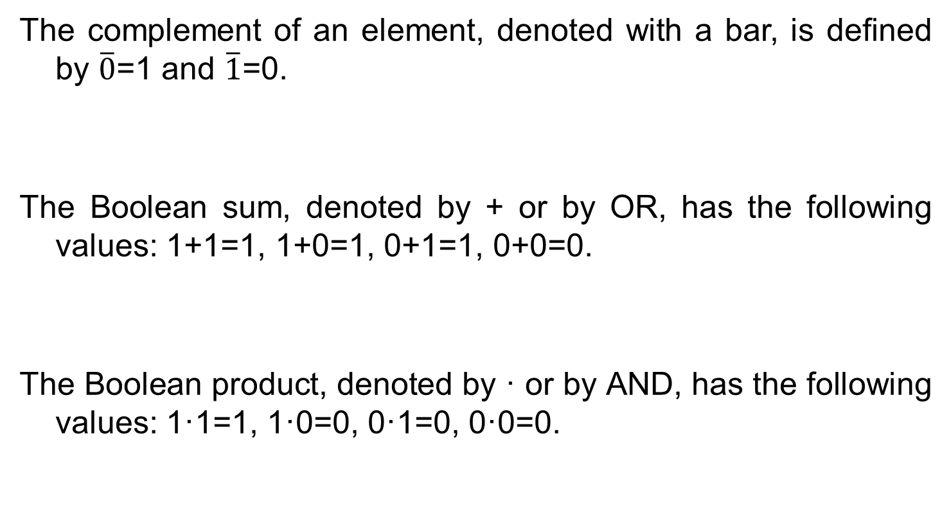
Basic rules
The complement of an element, denoted with a bar, is deﬁned by $\overline{0}$=1 and $\overline{1}$=0.
The Boolean sum, denoted by + or by OR, has the following values: 1+1=1, 1+0=1, 0+1=1, 0+0=0.
The Boolean product, denoted by · or by AND, has the following values: 1·1=1, 1·0=0, 0·1=0, 0·0=0.

Slide 7
Basic operators
Rules of precedence for Boolean operators are: ﬁrst, all complements are computed, followed by all Boolean products, followed by all Boolean sums.
The complement, Boolean sum, and Boolean product correspond to the logical operators, ¬, ∨, and ∧, respectively, where 0 corresponds to F (false) and 1 corresponds to T (true).

Slide 8
Boolean Function
Let B ={ 0,1}. Then B_{n} ={(x1,x2,...,xn) | xi ∈ B for 1≤ i ≤ n} is the set of all possible n -tuples of 0s and 1s.
The variable x is called a Boolean variable if it assumes values only from B, that is, if its only possible values are 0 and 1.
A function from B_{n} to B is called a Boolean function of degree n.
Boolean functions can be represented using expressions made up from variables and Boolean operations.

Slide 9
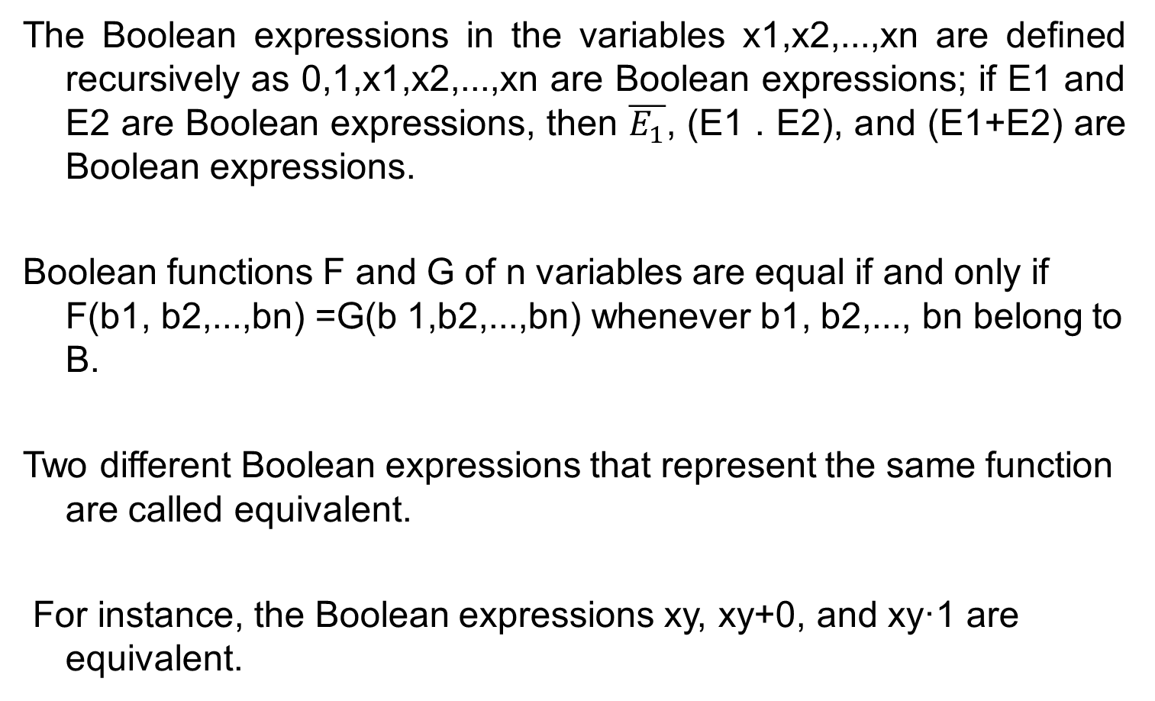
Boolean expression
The Boolean expressions in the variables x1,x2,...,xn are deﬁned recursively as 0,1,x1,x2,...,xn are Boolean expressions; if E1 and E2 are Boolean expressions, then $\overline{E_{1}}$, (E1 . E2), and (E1+E2) are Boolean expressions.
Boolean functions F and G of n variables are equal if and only if F(b1, b2,...,bn) =G(b 1,b2,...,bn) whenever b1, b2,..., bn belong to B.
Two different Boolean expressions that represent the same function are called equivalent.
For instance, the Boolean expressions xy, xy+0, and xy·1 are equivalent.

Slide 10
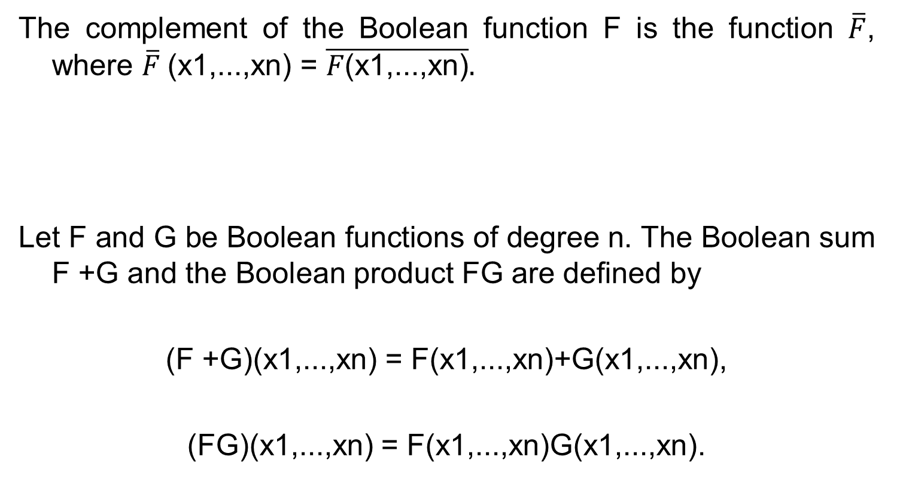
Function properties
The complement of the Boolean function F is the function $\overline{F}$, where $\overline{F}$(x1,...,xn) = $\overline{F\text{(}\text{x}\text{1,...,}\text{xn}\text{)}}.$
Let F and G be Boolean functions of degree n. The Boolean sum F +G and the Boolean product FG are deﬁned by
(F +G)(x1,...,xn) = F(x1,...,xn)+G(x1,...,xn),
(FG)(x1,...,xn) = F(x1,...,xn)G(x1,...,xn).

Slide 11
Number of Boolean function
How many different Boolean functions of degree n are there?
From the product rule for counting, it follows that there are 2^{n} different n-tuples of 0 s and 1 s .
Because a Boolean function is an assignment of 0 or 1to each of these 2^{n} different n-tuples, the product rule shows that there are 2^{2^n} different Boolean functions of degree n.
How many different Boolean functions are there of degree 7?

Slide 12
Laws

Slide 13
Problem
Show that F(x, y, z) = xy + xz + yz has the value 1 if and only if at least two of the variables x, y, and z have the value 1.

Slide 14
Problem
The Boolean operator ⊕, called the XOR operator, is defined
by 1 ⊕ 1 = 0, 1 ⊕ 0 = 1, 0 ⊕ 1 = 1, and 0 ⊕ 0 = 0.
Show that these identities hold.
a) x ⊕ y = (x + y)(xy)’
b) x ⊕ y = (xy’) + (x’y)

Slide 15
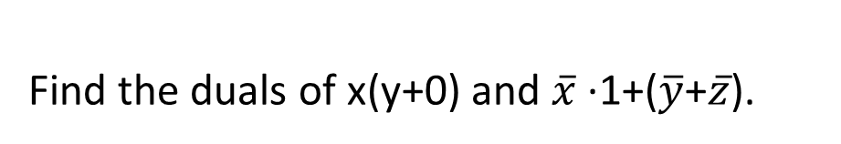

Dual
The dual of a Boolean expression is obtained by interchanging Boolean sums and Boolean products and interchanging 0s and 1s.
The dual’s are x+(y.1) and $(\overline{x}$ +0).($\overline{y}$.$\overline{z}$).
Find the duals of x(y+0) and $\overline{x}$ ·1+($\overline{y}$+$\overline{z}$).

Slide 16
Disjunctive normal form
Literals : A literal is a Boolean variable or its complement.
Minterm : A minterm of the Boolean variables x1,x2,...,xn is a Boolean product y1y2 ...yn, where yi = xi or yi = ¯ xi. Hence, a minterm is a product of n literals, with one literal for each variable.
Disjunctive Normal Form The disjunctive normal form(DNF) of a degree-n Boolean function f is the unique sum of minterms of the variables x1,...,xn that represents f.

Slide 17
Conjunctive Normal Form
Maxterm: A maxterm of the Boolean variables x1,x2,...,xn is a Boolean sum y1 + y2 + ... + yn, where yi = xi or yi = ¯ xi. Hence, a maxterm is a sum of n literals, with one literal for each variable.
The conjunctive normal form (CNF) of a degree-n Boolean function f is the unique product of maxterms of the variables x1,...,xn that represents f.

Slide 18
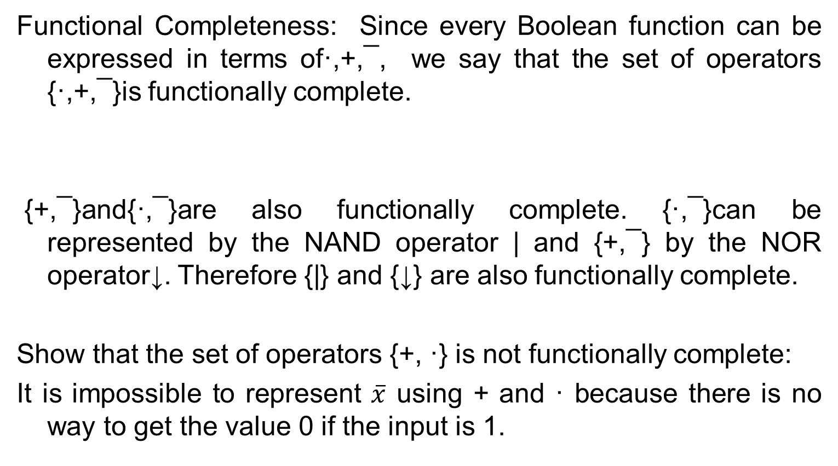
Functionally complete
Functional Completeness: Since every Boolean function can be expressed in terms of·,+,¯, we say that the set of operators {·,+,¯}is functionally complete.
{+,¯}and{·,¯}are also functionally complete. {·,¯}can be represented by the NAND operator | and {+,¯} by the NOR operator↓. Therefore {|} and {↓} are also functionally complete.
Show that the set of operators {+, ·} is not functionally complete:
It is impossible to represent $\overline{x}$ using + and · because there is no way to get the value 0 if the input is 1.

Slide 19
Sum of products (DNF)
A Boolean sum of minterms has the value 1 when exactly one of the minterms in the sum has the value 1.
It has the value 0 for all other combinations of values of the variables.
Consequently, given a Boolean function, a Boolean sum of minterms can be formed that has the value 1 when this Boolean function has the value 1, and has the value 0 when the function has the value 0.

Slide 20
Sum of products
The minterms in this Boolean sum correspond to those combinations of values for which the function has the value 1.
The sum of minterms that represents the function is called the sum-of-products expansion or the disjunctive normal form of the Boolean function.

Slide 21
Product of sums
A Boolean function by taking a Boolean product of Boolean sums. The resulting expansion is called the conjunctive normal form or product-of-sums expansion of the function.
These expansions can be found from sum-of-products expansions by taking duals.

Slide 22
Fact
Every Boolean function can be expressed as a Boolean sum of minterms.
Each minterm is the Boolean product of Boolean variables or their complements.
This shows that every Boolean function can be represented using the Boolean operators ·,+, and −.
Because every Boolean function can be represented using these operators we say that the set{·,+,−}is functionally complete.

Slide 23
Abstract definition

Slide 24
NAND Operator
Define two operators, the | or NAND operator, defined by
1 | 1 = 0 1 | 0 = 0 | 1 = 0 | 0 = 1;
and the ↓ or NOR operator, defined by
1 ↓ 1 = 1 ↓ 0 = 0 ↓ 1 = 0 and 0 ↓ 0 = 1.

Slide 25
Problem
Find a Boolean product of the Boolean variables x, y, and z, or their complements, that has the value 1 if and only if
a) x = y = 0; z = 1
Since x = y = 0, then x’ = y ‘= 1. The boolean product is simply x’y’z.
b) x = 0; y = 1; z = 0
x’yz’
c) x = 0; y = z = 1
x’yz

Slide 26
Problem
Find the sum-of-products and product of sums expansions of these Boolean functions.
a) F(x, y, z) = x + y + z
b) F(x, y, z) = (x + z)y
c) F(x, y, z) = x
d) F(x, y, z) = x y

